Slide 1
STOCK PORTFOLIO TRACKER
D.SPOORTHI
MALLAREDDY ENGINEERING FOR WOMEN

Slide 2
INTRODUCTION
Stock Portfolio Tracker is a simple Python application.
It calculates the total investment value of stocks.
Users enter stock names and quantities.
The program uses predefined stock prices.

Slide 3
OBJECTIVE
The objective of this project is to develop a simple Stock Portfolio Tracker using Python that allows users to enter stock names and quantities, calculates the investment value based on predefined stock prices, and displays the total investment amount. This project helps in understanding dictionaries, user input, loops, and basic arithmetic operations in Python.

Slide 4
TOOLS
Python
Dictionary
Input/Output Functions
Basic Arithmetic Operations

Slide 5
REQUIREMENTS
Python 3.x
Any Python IDE (IDLE, VS Code, PyCharm, etc.)
Basic knowledge of Python programming
Predefined stock price data stored in a dictionary
Computer/Laptop to run the program

Slide 6
WORKING
Store stock prices in a dictionary.
Take stock name and quantity from user.
Calculate investment value.
Add all values.
Display total investment.

Slide 7
SOURCE CODE
stocks = {
"AAPL": 180,
"TSLA": 250,
"GOOGLE": 150,
"MSFT": 300
}
total = 0
print("Stock Portfolio Tracker")
for i in range(2):
stock = input("Enter stock name: ").upper()
quantity = int(input("Enter quantity: "))

Slide 8
SOURCE CODE
if stock in stocks: value = stocks[stock] * quantity total = total + value print("Value =", value) else: print("Stock not found") print("Total Investment =", total)

Slide 9
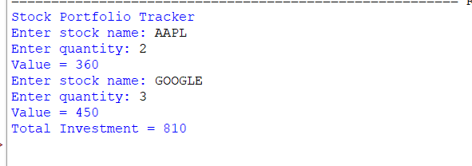
OUTPUT

Slide 10
ADVANTAGES
Simple and easy to use.
Calculates total investment quickly.
Reduces manual calculation errors.
Helps users track their stock investments.
Uses basic Python concepts, making it beginner-friendly.
Can be enhanced in the future with real-time stock prices and more features.

Slide 11
LIMITATIONS
Uses only predefined stock prices.
Does not fetch real-time stock market data.
Supports only a limited number of stocks.
No graphical user interface (GUI).
Investment data is not stored permanently unless file handling is added.
Does not calculate profit, loss, or market trends.

Slide 12
CONCLUSION
The Stock Portfolio Tracker was successfully developed using Python. It allows users to enter stock names and quantities, calculates the investment value, and displays the total investment amount. This project helped in understanding Python concepts such as dictionaries, loops, user input, and arithmetic operations while providing a simple way to track stock investments.

Slide 13
FUTURE ENHANCEMENTS
Add real-time stock prices using APIs.
Develop a graphical user interface (GUI).
Store portfolio data in a database.
Calculate profit and loss automatically.
Support more stocks and investment options.
Generate reports and charts for better analysis.

